Slide 1
Cat and Dog Shelter Trends

Slide 2
Questions:
Are cats or dogs more likely to be dropped of at the shelter?
Are there more animals of a specific age, breed, or coat color?
Most common reasons for intake?
Most common reasons why animals are returned?
Are there seasonal patterns for shelter intake, movement, and return?

Slide 3
The Data
Animal Care and Control Adopted Animals
https://www.kaggle.com/datasets/jinbonnie/animal-data
Data from Bloomington Animal Shelter

Slide 4
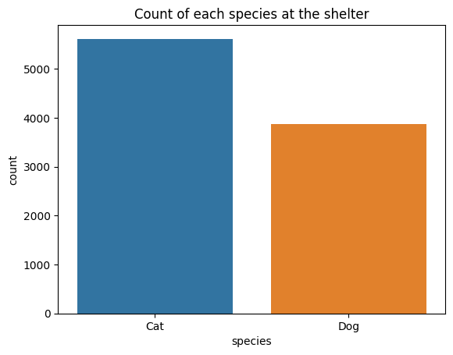
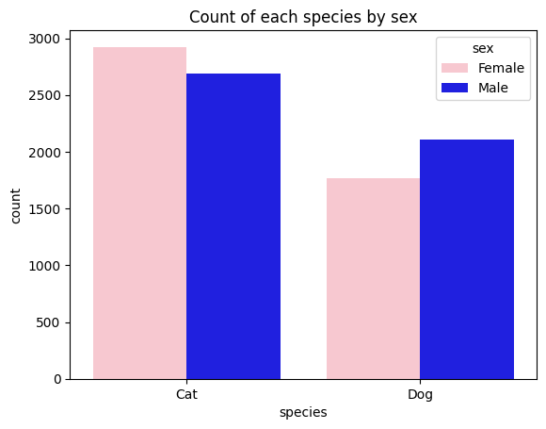
Animals in the shelter by species and sex
Notes:
From now on, Blue = cat, Orange = dog

Slide 5
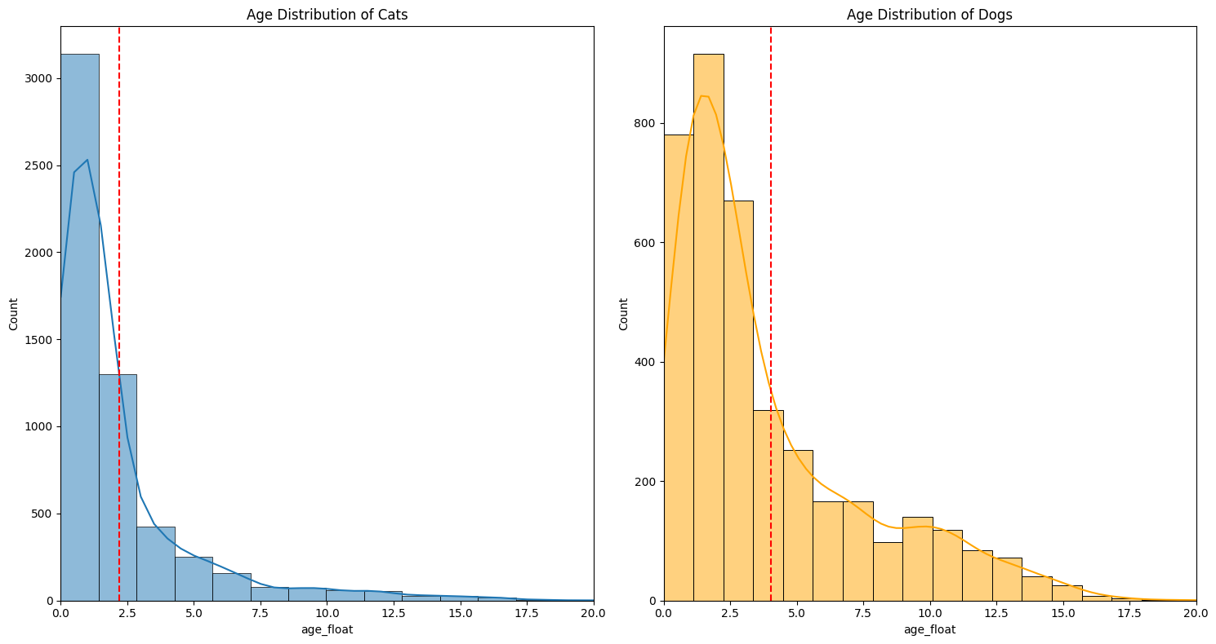
Age distribution by species
Notes:
Mean age of cats is ~ 2.5
Dogs is ~ 4

Slide 6
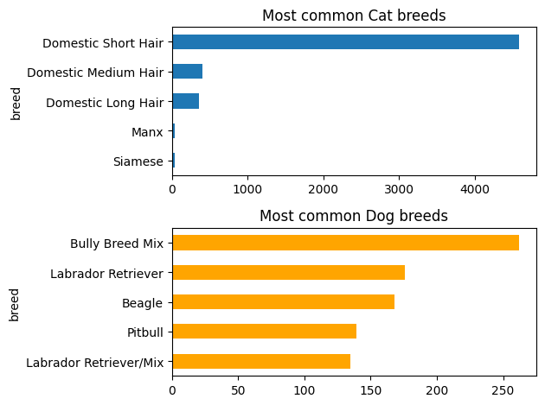
Shelter animals by breed
Mostly mixed-breed cats
Lab and bull mixes are the most common dog breeds

Slide 7
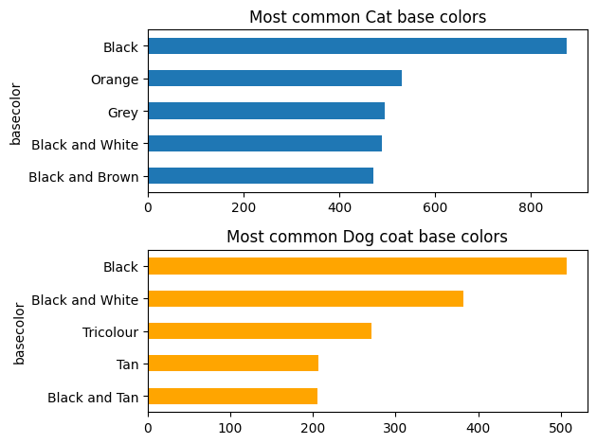
Shelter animals by color
Notes:
Most cats and dogs in the shelter have black coats

Slide 8
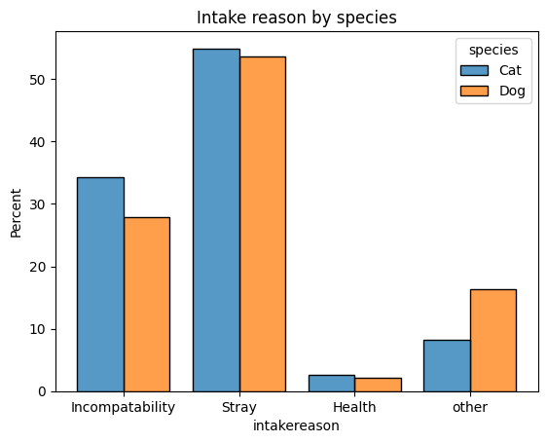
Intake reasons
Incompatibility: moving/lifestyle issues, litter box problems
Stray: stray, abandoned, TNR, owner died
Health: allergies, sick/injured, owner requested euthanstasia

Slide 9
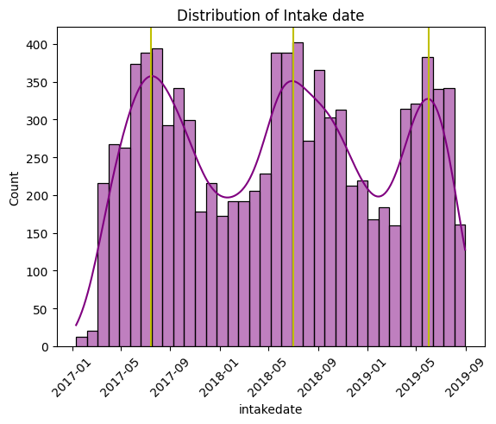
Distribution of Intake Dates
Most common in summer
Least common in winter
Notes:
Yellow lines: Aug 2017, Aug 2018, June 2019

Slide 10
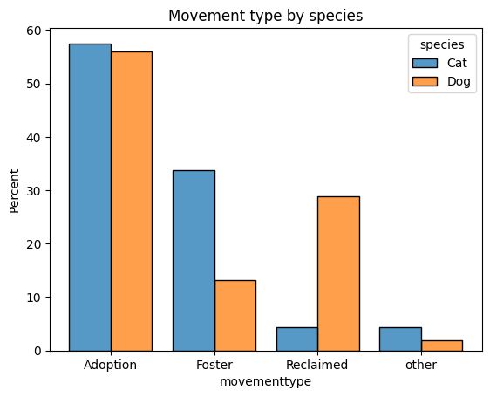
Movement type by species
Other: transfer, stolen, released to the wild, or escaped
Notes:
Dogs are more likely to be reclaimed than cats.
Cats are more likely to be fostered.

Slide 11
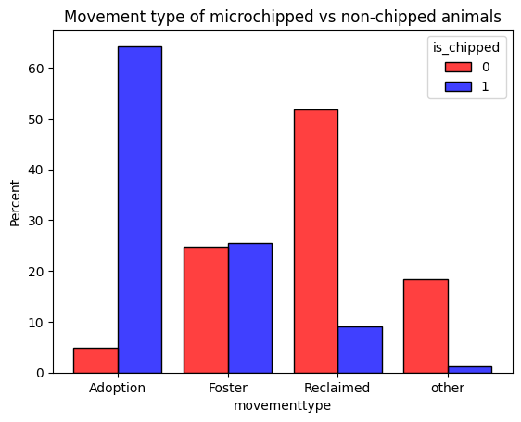
Movement type: microchip status
~87.44% of the animals were microchipped
Other: transfer, stolen, released to the wild, or escaped
Notes:
Surprisingly 50% of non-chipped animals were reclaimed by their owners.
Yet it is not surprising that non-chipped animals are likely to get stolen than chipped animals

Slide 12
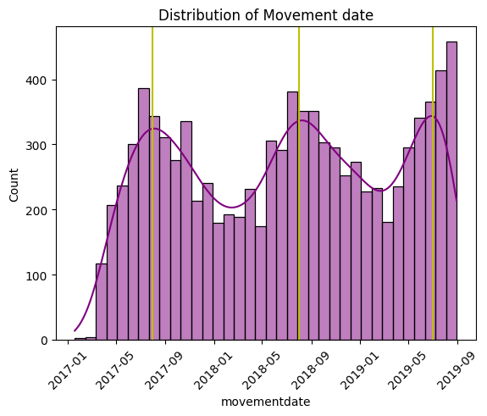
Distribution of movement dates
Notes:
Same pattern as intake date: common in summer/fall, least common in winter.
Yellow lines: sep 2017, aug 2018 & june 2019

Slide 13
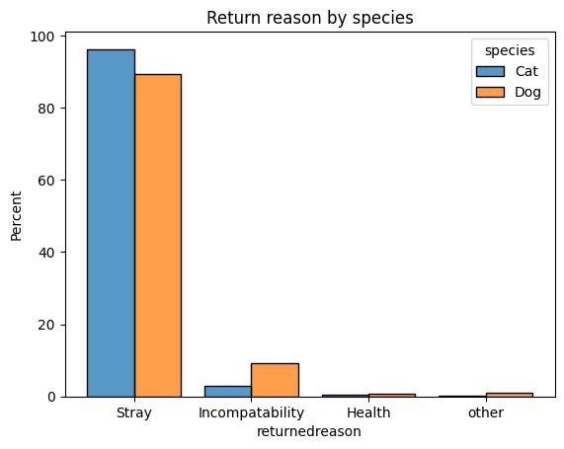
Return reason
Incompatibility: moving/lifestyle issues, litter box problems
Stray: stray, abandoned, TNR, owner died
Health: allergies, sick/injured, owner requested euthanstasia

Slide 14
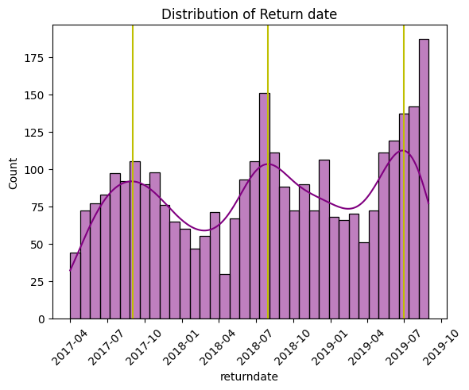
Distribution of Return dates
Notes:
Yellow lines: # sep 2017, aug 2018 & june 2019

Slide 15
Questions:
Are cats or dogs more likely to be dropped off at the shelters?
Are there more animals of a specific age, breed, or coat color?
Most common reasons for intake?
Most common reasons why animals are returned?
Are there seasonal patterns for shelter intake, movement, and return?

Slide 16
Answers:
There are more CATS than dogs at Bloomington Shelter
Most animals were young
Mean cat age: 2.5 years
Mean dog age: 4 years
Most animals there have BLACK coats
Mixed-breed cats, bully mix dogs, and lab mix dogs are most common
Most animals in the shelter were strays, abandoned, or their owner died.
Incompatibility with owner was the 2nd reason.
Intakes, movements, and returns are highest in summer, and lowest in winter

